Slide 1
PATHFINDER Conversation Guide
Welcome!
The Pathfinder Conversation Guide will help identify your
customers alignment philosophy in Total Knee Arthroplasty (TKA).
Click 'Start' to begin.
Start
Notes:
Show adjacent philosophies, to encourage thought on new philosophies

Slide 2
Choose one…
Femur First
Tibia First
Notes:
No points awarded, follow decision tree.

Slide 3
What do you prioritize when performing Total Knee Arthroplasty (TKA)?
Select one option:
Aiming for a neutral mechanical alignment (0deg HKA)
Restoring the patient’s native alignment
Prioritizing balanced flexion and extension gaps
Notes:
Neutral mechanical alignment (0° HKA) = +2 MA
Restore native alignment = +2 KA
Prioritize balanced flexion/extension gaps = +2 FA
Might not be primary goal, “which of these resonates with you?”

Slide 4
Do you adjust your resections to balance the soft tissue?
Yes
No

Slide 5
Are you willing to deviate from mechanical axis (0° HKA)?
Select one option:
Yes
No
Notes:
Yes= +1 KA / +1 iKA / +1 FA
No= +2 MA
Can we shorten question
This question should be, “Do you adjust soft tissues”
If they answer yes, go to slide 6 & 7

Slide 6
The distal femoral resection should:
Select one option:
Be used to balance– adjusts the femoral resection within boundaries to obtain the target gaps.
Be perpendicular to mechanical axis– the femoral resection is aligned perpendicular to the femur’s mechanical axis.
Restore native joint line obliquity– the femoral resection is positioned to restore the joint line to pre-arthritic position.
Notes:
Balance gaps (adjust within boundaries) = +1 FA / +1 iKA
Perpendicular to mechanical axis =+2 MA
Restore native joint line = +2 KA
You may know the answers to these questions depending on how they answer the first two questions

Slide 7
The tibial resection should:
Select one option:
Be used to balance– adjusts the tibial resection within boundaries to obtain the target gaps.
Be perpendicular to mechanical axis- the tibial resection is aligned perpendicular to the tibia’s mechanical axis.
Restore native joint line obliquity- the tibial resection is positioned to restore the joint line to pre-arthritic position.
Notes:
Balance gaps (adjust within boundaries) = +1 FA / +1 iKA
Perpendicular to mechanical axis = +2 MA
Restore native joint line = +2 KA

Slide 8
When balancing extension gaps, the priority is:
Select one option:
Minimize tibial varus -prioritizes neutral tibia, adjusts femur component to balance extension gaps.
Minimize femoral joint line deviation–prioritizes native femur joint line, adjusts tibia component to balance gaps
Evenly distribute changes to femur/tibia –prioritizes neutral femur and tibia, splits varus/valgus adjustments between both components to balance gaps.
Notes:
Minimize tibial varus = +2 MA
Minimize femoral joint line deviation = +2 KA
Evenly distribute changes = +2 FA
Only appears If choosing balance/balance

Slide 9
The posterior femoral resection should:
Select one option:
Restore both medial and lateral posterior condylar offsets– both medial and lateral posterior resections aim to recreate the pre-arthritic posterior condylar offset.
Restore medial posterior condylar offset and use lateral resection to balance– the medial posterior resection recreates the pre-arthritic medial posterior condylar offset, and the lateral posterior resection is used to balance gaps.
Use both medial and lateral resections to balance– both medial and lateral posterior resections are used to balance gaps to obtain the intended ligament tension.
Notes:
Restore both medial/lateral offsets = +2 KA
Restore medial offset, lateral used for balance = +2 iKA
Both medial and lateral used to balance = +2 FA
Is this something that should be asked to FA surgeon after alignment philosophy is determined

Slide 10
Do you apply coronal boundaries (limits to deviation)?
Select one option:
Yes
No
Notes:
Yes =+1 iKA / +1 FA
No = +2 KA
Pop out for on-lable usage of ATTUNE Knee System

Slide 11
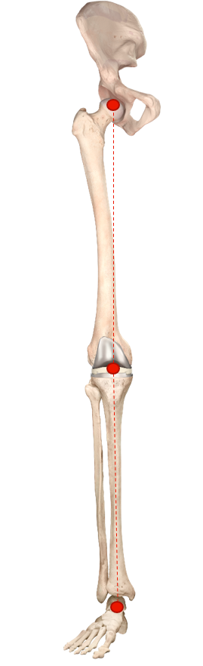
Mechanical Alignment (MA)
Your approach suggests: Mechanical Alignment (MA)
Restart
Mechanical Alignment with balancing starts off with standard mechanical alignment that aims for a neutral HKA. The femur position is then adjusted to balance flexion and extension gaps. The tibia proximal resection depths are then adjusted if needed. This technique prioritizes minimizing femur and tibia deviation from neutral.

Slide 12
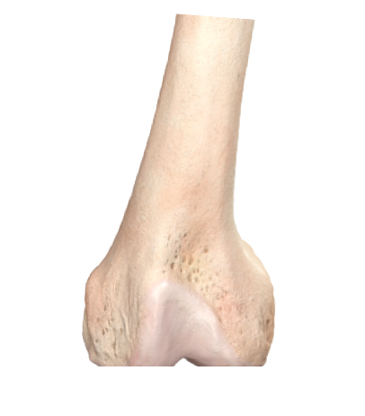
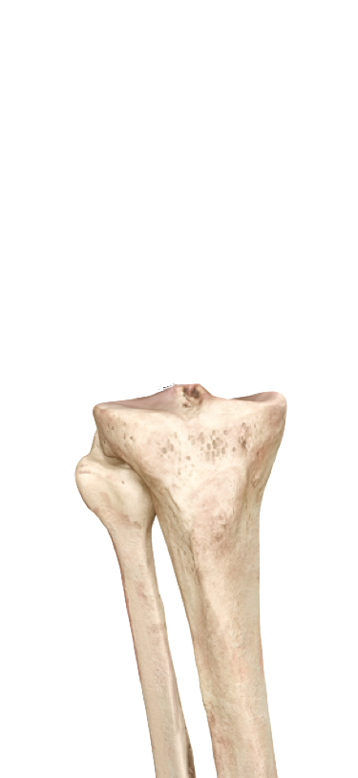
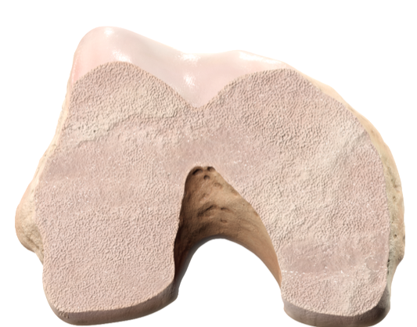
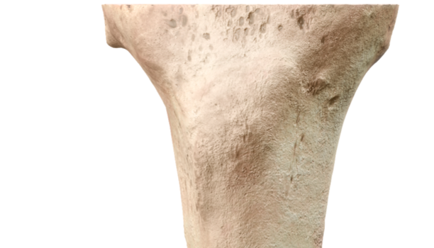
Kinematic Alignment (KA)
Your approach suggests: Kinematic Alignment (KA)
Restart
1.
Kinematic Alignment prioritizes restoring the native joint line. The femur is resurfaced first. Next, the tibia is resurfaced. Femoral and tibial resection depths are planned as the implant thickness minus the estimated cartilage and bone wear values.
2.
0°

Slide 13
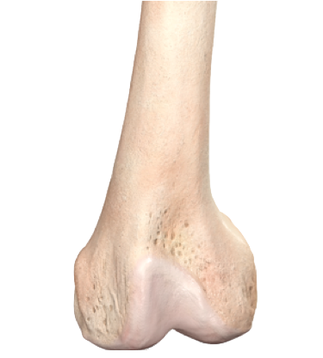
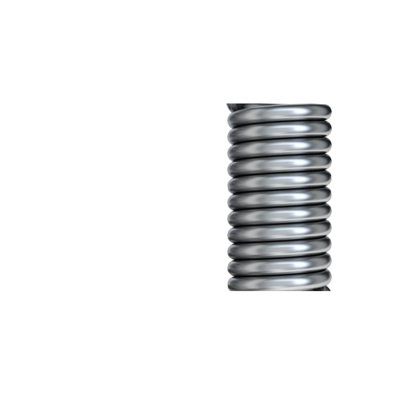
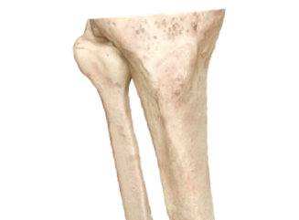

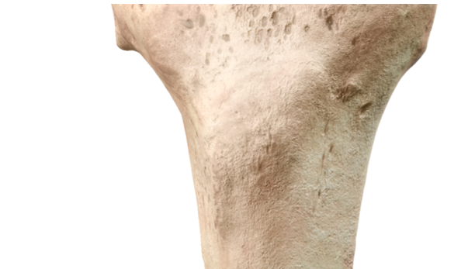
Inverse Kinematic Alignment (iKA)
Your approach suggests: Inverse Kinematic Alignment (iKA)
Restart
2.
Inverse Kinematic Alignment aims to resurface the proximal tibia back to its pre-arthritic state. The tibial resection thickness assumes the minimum tibial insert is used and is equal to implant thickness minus cartilage and bone wear. The tibia is resurfaced, and osteophytes are resected. The soft tissues of the knee are assessed using the CAS tensioner and ACCUBALANCE™ Graph before proceeding with the femoral resections. The femoral resection depth and angulations are planned in a way to balance gaps using the ACCUBALANCE Graph and obtain the intended soft tissue balance of the knee.
1.
?°

Slide 14
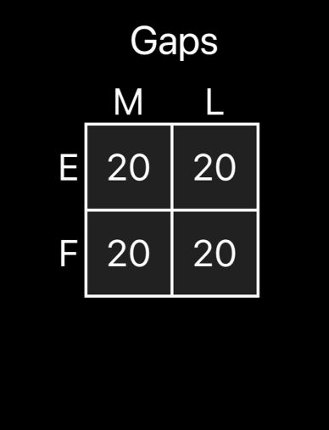
Functional Alignment (FA)
Your approach suggests: Functional Alignment (FA)
Restart
Functional alignment aims to provide balanced flexion-extension gaps. The Functional Alignment planning method enables adjustments in the coronal plane for both the distal femoral and proximal tibial resections to achieve the desired soft tissue laxity symmetry on the ACCUBALANCE™ Graph.
Notes:
Switch to ACCUBALANCE Graph image

Slide 15
Primary & Secondary Philosophy
Your approach suggests: Hybrid
Restart
Notes:
Primary & Secondary? Don’t like “hybrid”
Do we want to call this something more poignant? Most of the KOL’s are doing a hybrid kinematic technique
VELYS Enabled Technique?

Slide 16
Scoring Weights
MA (Mechanical Alignment): Heavily favored by neutral mechanical axis goals, mechanical cuts, minimizing tibial varus, no deviation.
KA (Kinematic Alignment): Driven by native joint line restoration, "no boundary" mindset, restore femoral & tibial JLOs.
iKA (Inverse Kinematic Alignment): Resurface tibia first, balance with femur, uses coronal boundaries, ACCUBALANCE-driven.
FA (Functional Alignment): Focus on gap balancing, adjust both tibia/femur together, evenly distribute extension gap changes.

Slide 17
Scoring Weights
Example
Question | Choice | Resulting Score
Primary Goal | Restore native alignment | +2 KA
Willingness to Deviate | Yes | +1 KA, +1 iKA, +1 FA
Femoral Resection | Restore native joint line | +2 KA
Tibial Resection | Restore native joint line | +2 KA
Balancing Extension Gaps | Minimize femoral joint line deviation | +2 KA
Posterior Resection | Restore both medial/lateral offsets | +2 KA
Boundaries | No | +2 KA
Final Score:
KA = 13 points
iKA = 1 point
FA = 1 point
MA = 0 points
Outcome:
Strong match = Kinematic Alignment (KA)
Notes:
Highest Point Total = Suggested Alignment Philosophy
Tie?: If two philosophies are close (within 2 points), offer “Hybrid or Patient Specific” recommendation

